Slide 1




Webscraping and Social Media Scraping [2400-DS1WSMS]
MOVIE / TV SHOW SCRAPER AND BROWSER
Marcin Miszkiel
Mateusz Tomczak
Project presentation 16.04.2024

Slide 2

It's a Flask Python web app designed to simplify data scraping from website and to browse and filter it faster.
For scraping data we utilized:
beautifulsoup4
selenium
scrapy
We used sqlite3 to store the data
and re, lamda to filter it.
Our primary focus is on gathering information about movies and TV shows.
Idea description

Slide 3
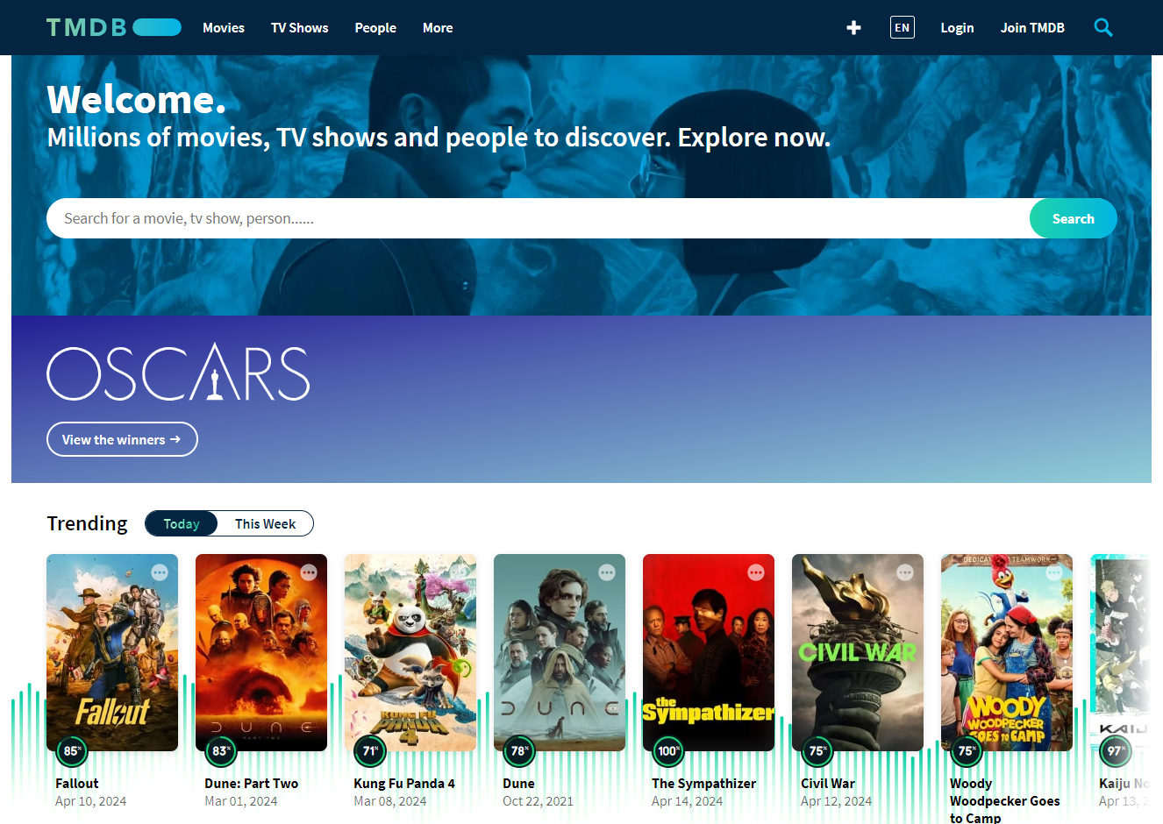

Slide 4

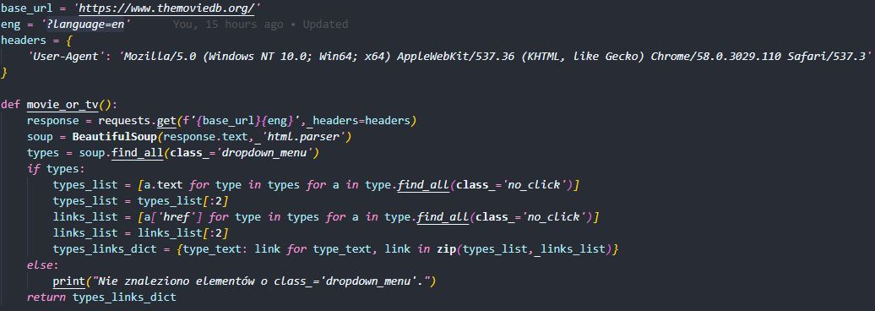
App Usage
Choose a type

Slide 5
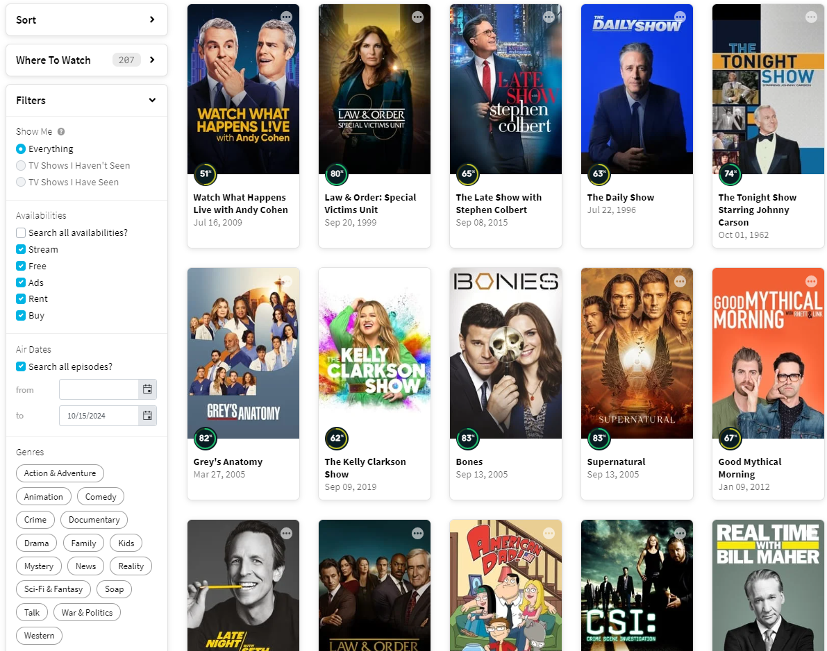

Slide 6
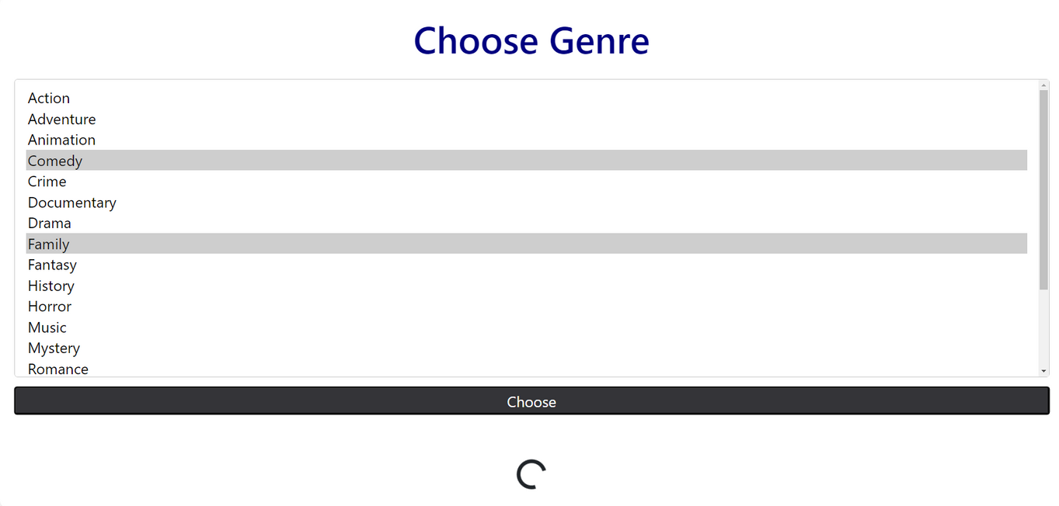
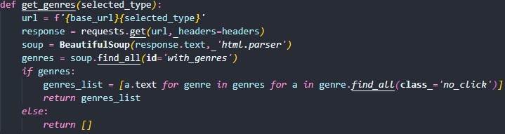
App Usage
Choose a genre

Slide 7
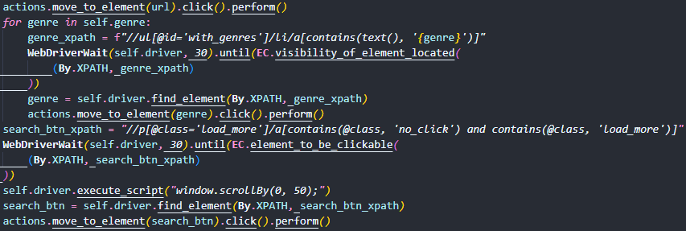
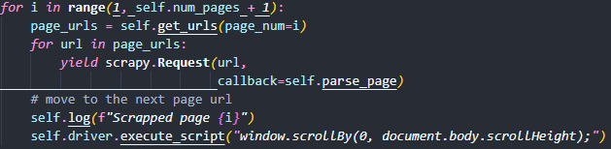
App Usage
Scraping main data
Movie/TV Series data is scrapped using scrapy and selenium.
Selenium is used to navigate the main page and load dynamic content.
We collect 20 links per ‘page’ using parse() method.
Then we yield scrapy.Response() object with every URL, that callbacks to the parse_page() method.

Slide 8
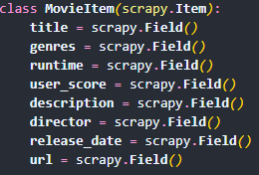
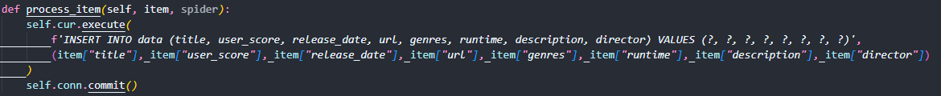
App Usage
Saving the data
The parse_page() method collects data from URL using BeautifulSoup and yields MovieItem object containing data of given movie/TV show.
Next, this data is inserted into an SQL database with the help of scrapy pipeline.

Slide 9
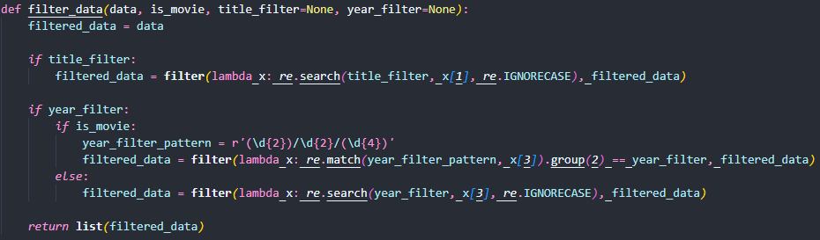
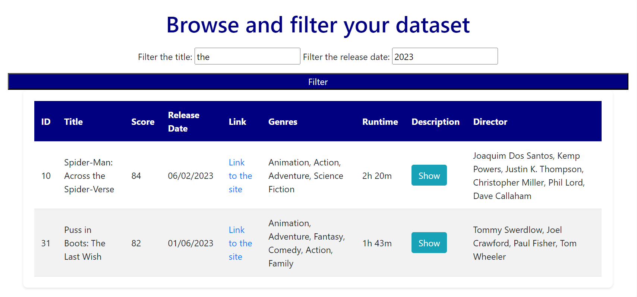
App Usage
Browse and filter the data

Slide 10
Webscraping and Social Media Scraping [2400-DS1WSMS]
THANK YOU FOR YOUR AUDIENCE
Marcin Miszkiel
Mateusz Tomczak
Project presentation 16.04.2024

